Slide 1
Applying design patterns in JS while working with Angular js
Aashish Kumar
https://github.com/aashishGitHub

Slide 2
Creational Patterns
Constructor
Prototype
Module
Factory
Singleton

Slide 3
Creating objects
var obj = {}
Var nextObj = Object.create(Object.prototype)
Var lastObj = new Object()
  Adding Properties
Object.defineProperty(obj, 'name', {
  value: 'my name',
  writable: true,
  enumerable: true,
  configurable: true
  })

Slide 4
Constructor Pattern
Create a new object with their own object scope, using New() constructor function
Attaches ‘this’
Links that object to Object.prototype
Returns this
function ObjectName(param1, param2){
    this.param1=param1;
    this.param2=param2;
    this.toString=function() {
    returnthis.param1+' '+this.param2;
    }
  }

Slide 5
Prototypes
An encapsulation of properties that an object links to
ClassName.Prototype.MethodName = function(){}
https://developer.mozilla.org/en-US/docs/Web/JavaScript/Reference/Global_Objects/Object/prototype

Slide 6
Module and Revealing module Pattern
Simple Way to Encapsulate Methods
An object literal with key values,
E.g. Service in angular js
  varModule = function() {
    var privateVar = 'I am private...';
    return {
    method: function() {..},
    nextMethod: function() {...}
    }
  }

Slide 7
Factory Pattern
A pattern used to simplify object creation
Talks about relationship one object can have with others
To keep your controller clean, achieve caching
Isolate logic to create object Eg: reading from config

Slide 8
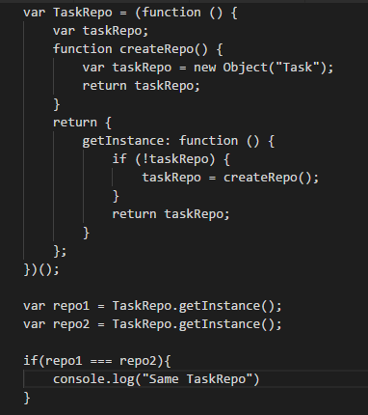
Singleton
Angular Services
are singleton as it
calls new() while
Creating it, they
use common.js

Slide 9
Structural Design Patterns
Concerned with how objects are made up and simplify relationships between objects.
Extend functionality
Simplify functionality
  Decorator Pattern
  Façade Pattern
  Flyweight Pattern

Slide 10
Decorator Pattern
Used to add new functionality to an existing object, without being obtrusive.
More complete inheritance in JS
Wraps an object
Protects existing objects (which is working)
Allows extended functionality
Angular provides decorators to wrap services

Slide 11
Façade Pattern
Used to provide a simplified interface to a complicated system.
Facade hides the chaos from us
Simplifies the interface
Example JQuery

Slide 12
Flyweight Pattern
Conserves memory by sharing portions of an object between objects.
Our tasks had lots of non unique data
Flyweight shares data across objects
Results in a smaller memory footprint
But only if you have large numbers of objects

